Slide 3


Slide 4
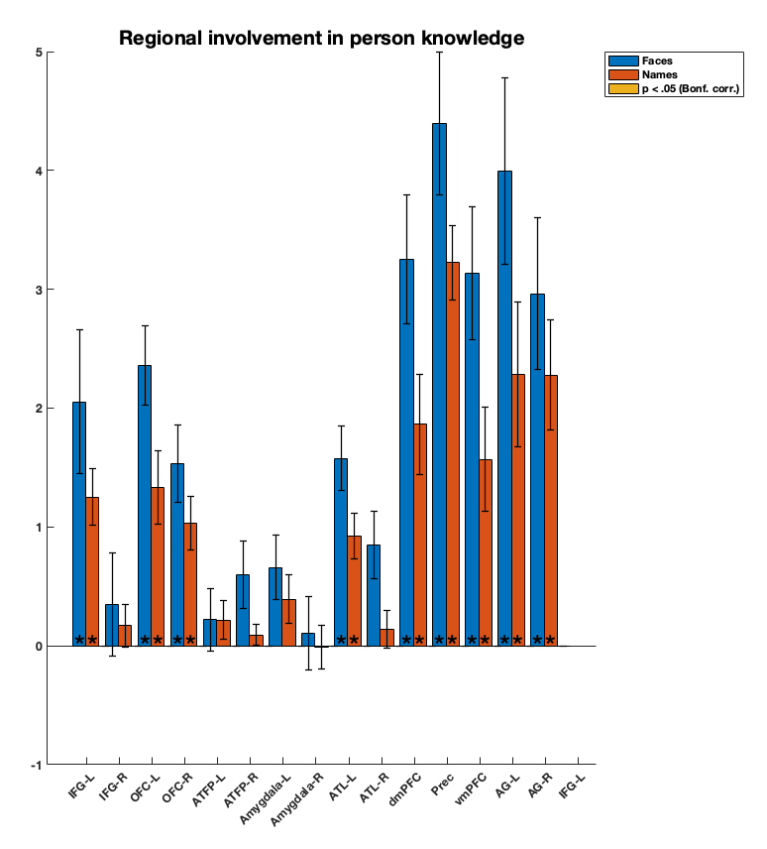
*

Slide 5
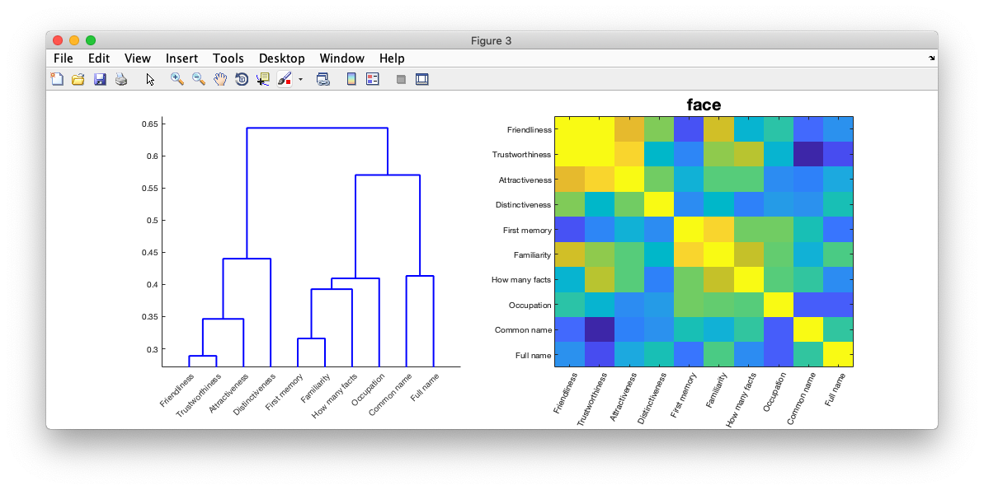
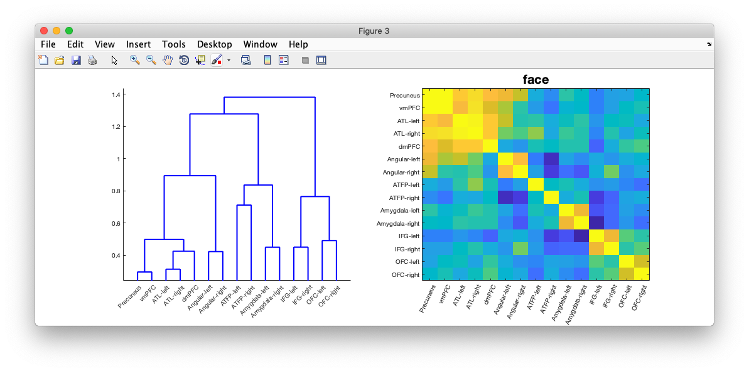
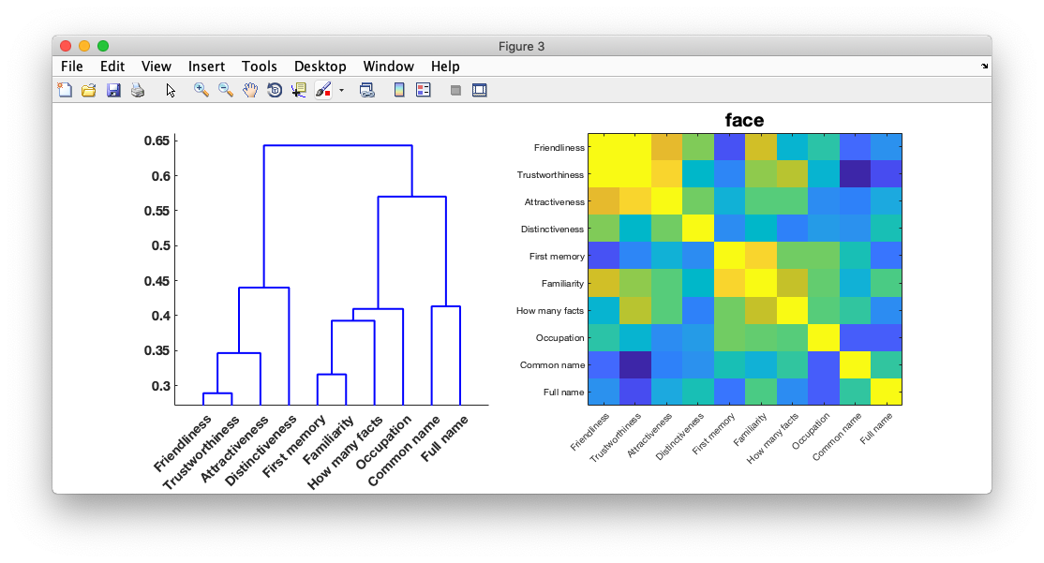
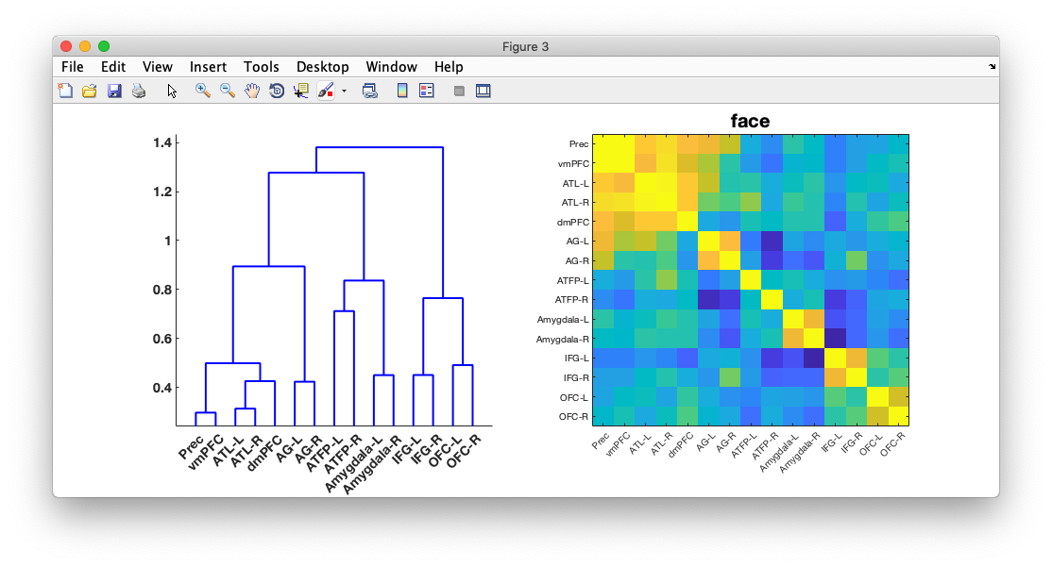
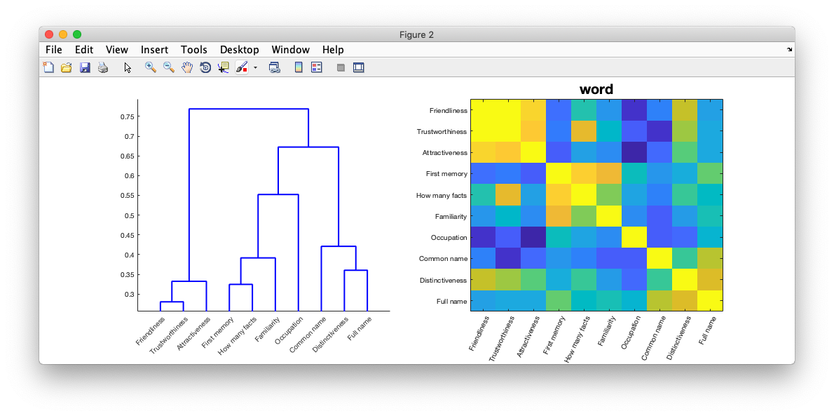
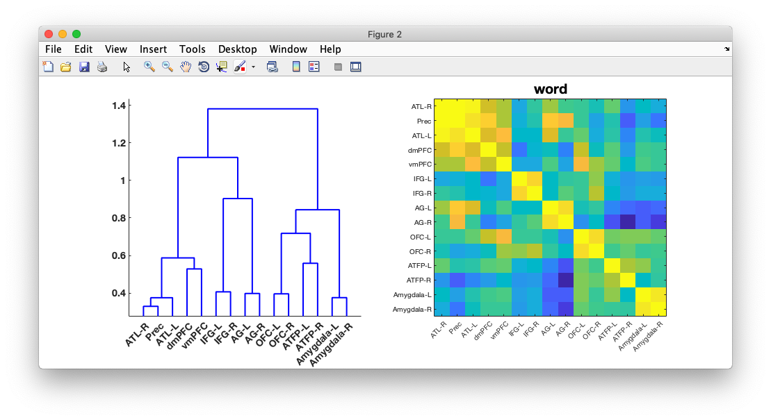
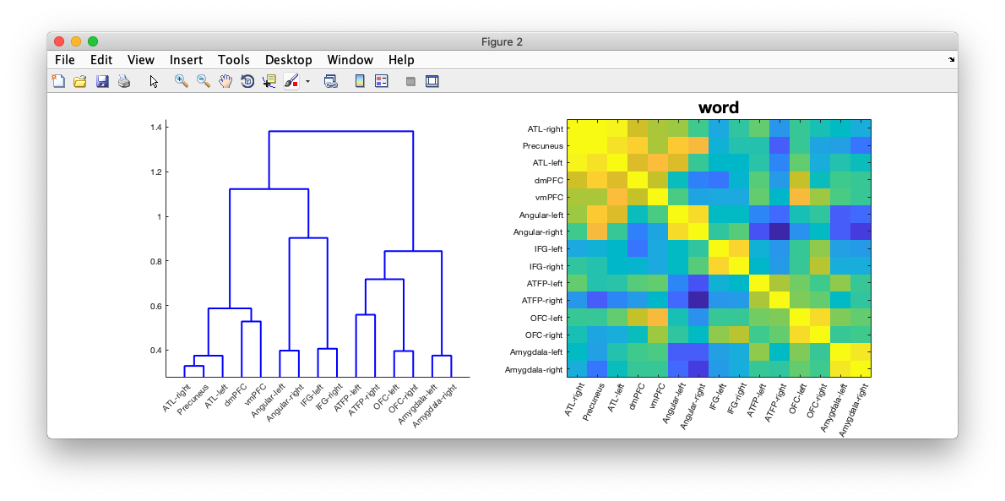
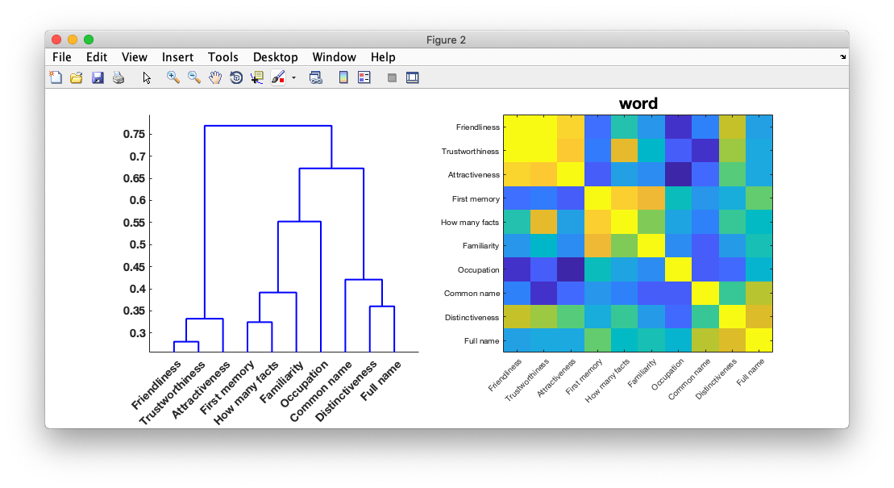
Faces
Model
Model
Correlate
Correlate
Data
Data
Names

Slide 6
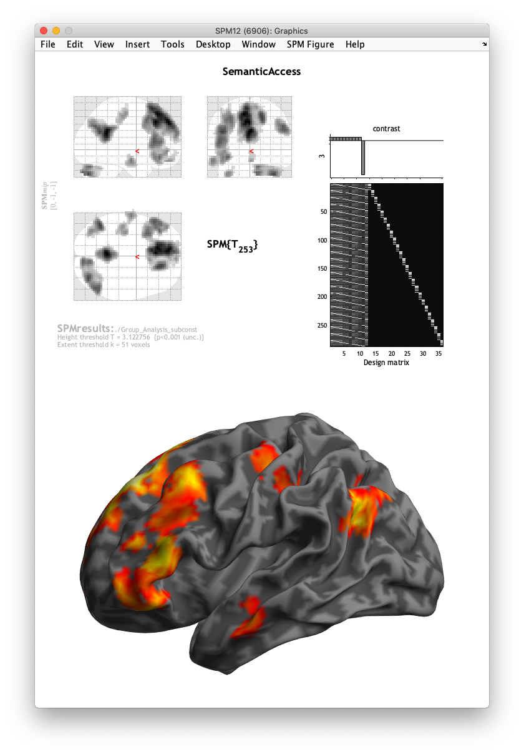
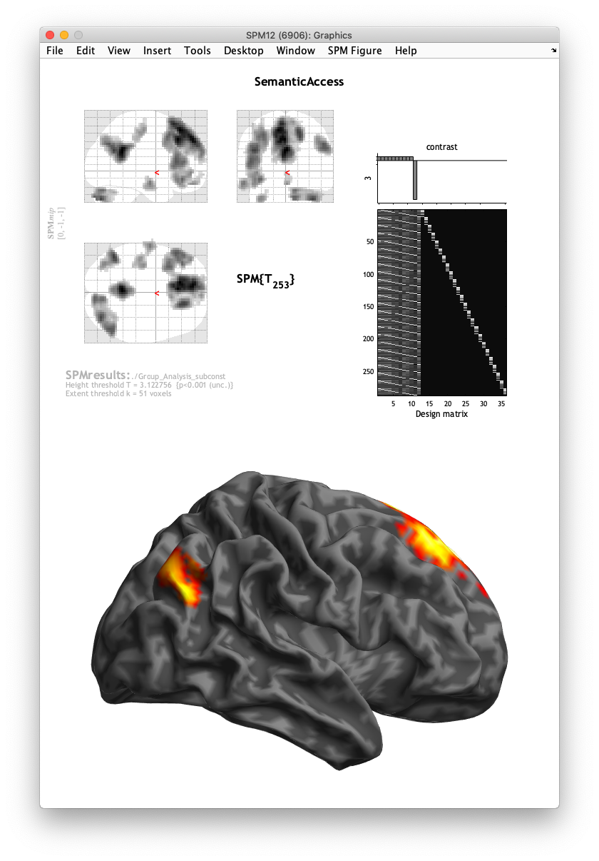
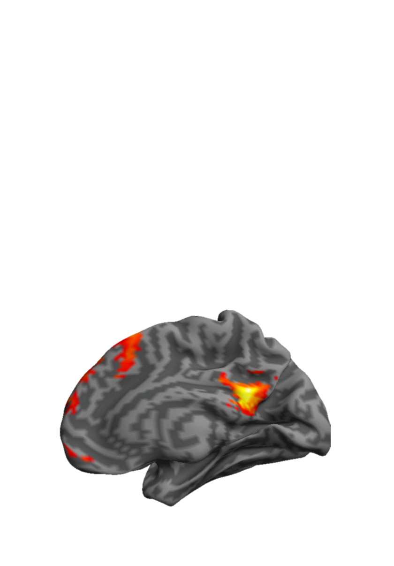
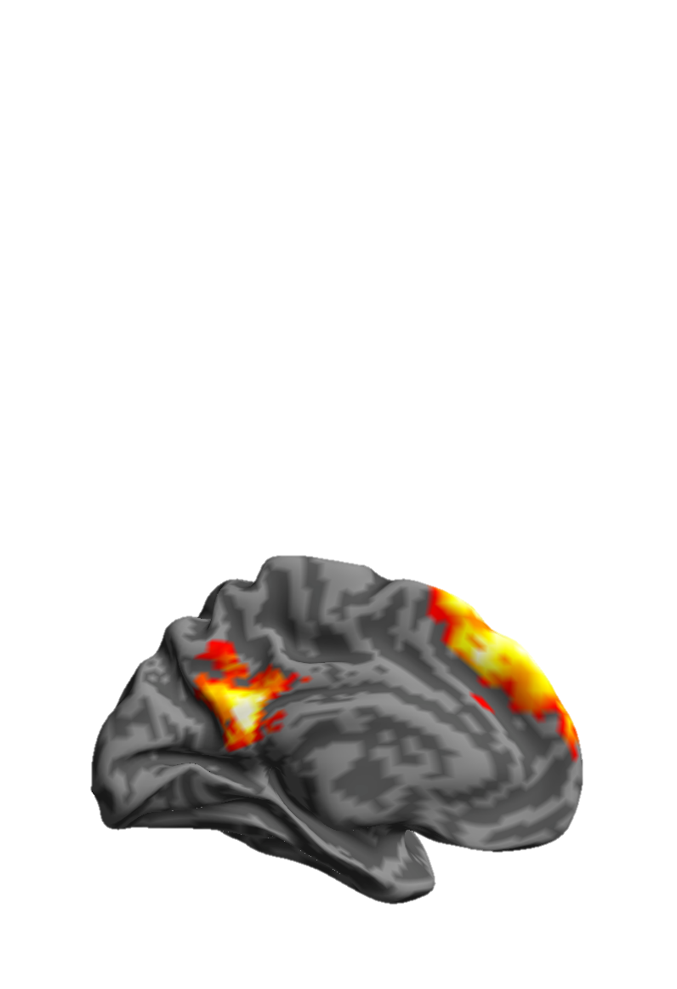
Names
Voxel p < .001
Cluster p < .05

Slide 7
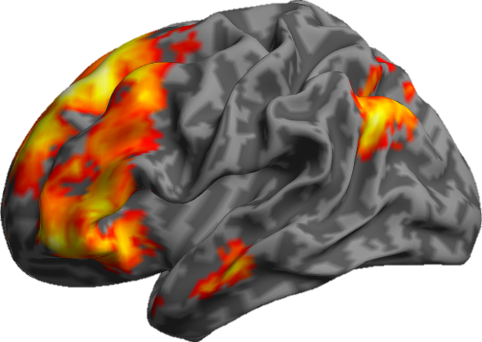
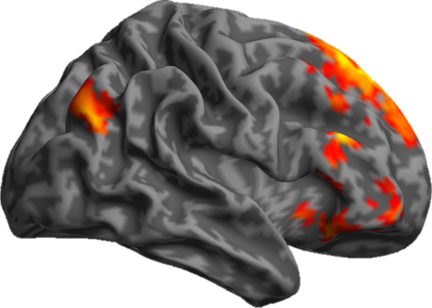
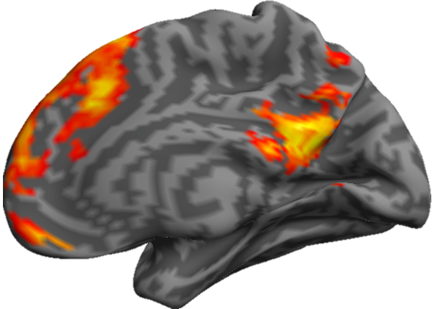
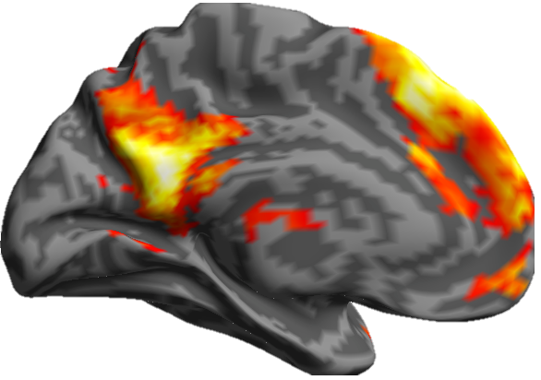
Faces

Slide 8
Names
Faces
Voxel p < .001
Cluster p < .05

Slide 9
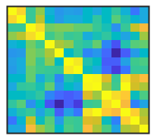
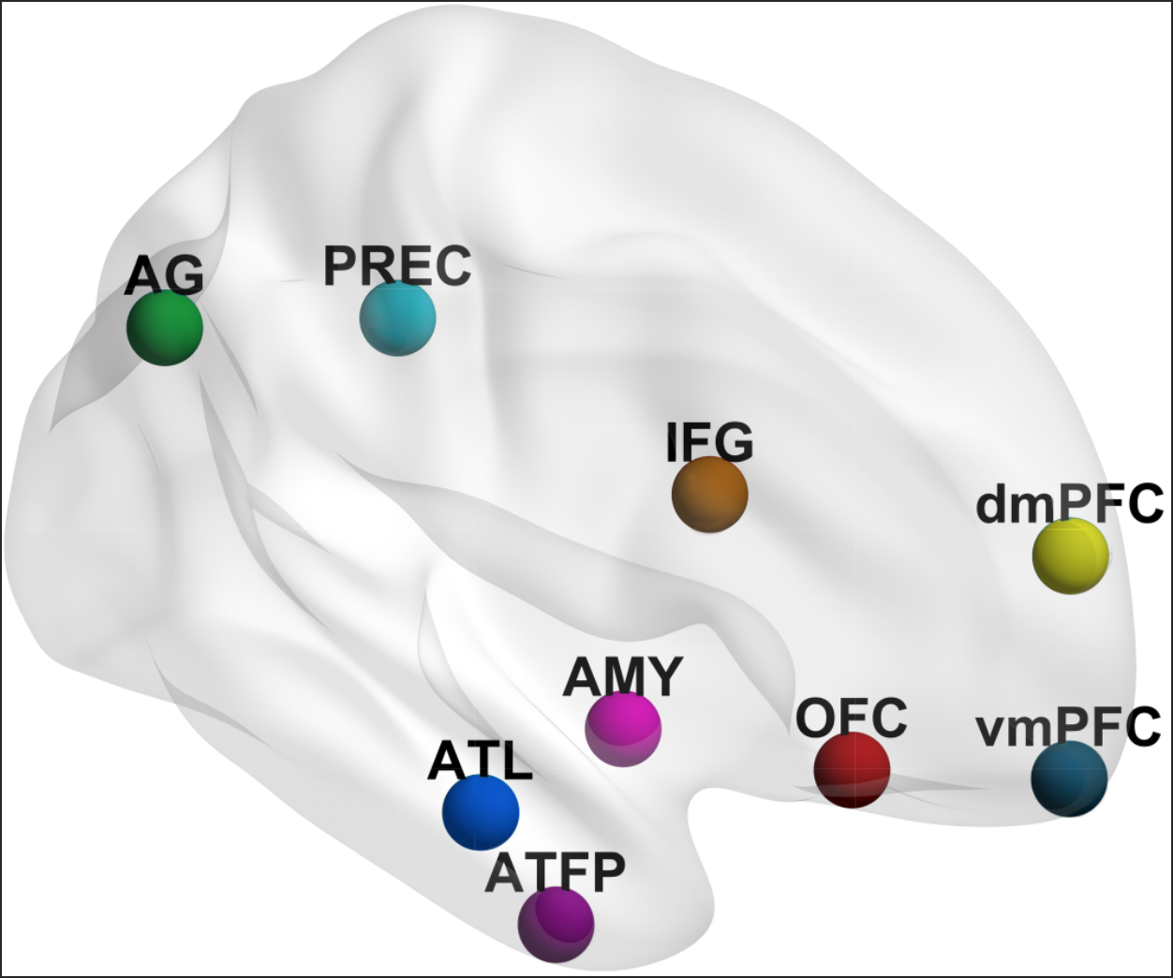
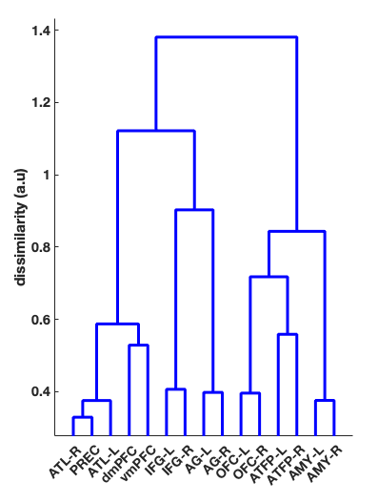
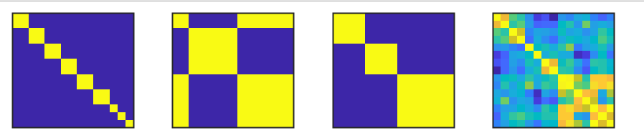
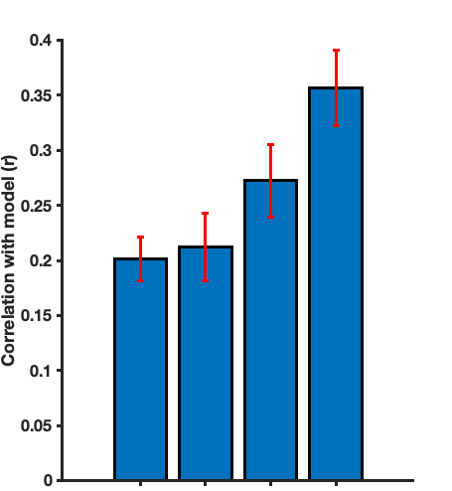
Pairwise Similarity Matrix
Regional similarity hypotheses
Regional Similarity Dendrogram
Pattern Similarity Matrix
Pattern similarity
Model fit
Pairs
Posthoc
Model fit comparison
*
**
**
*
* p < .05
*
** p < .001
n.s
Internalised/Externalised/Control
Empirical
Pairs
I/E/C
Posthoc
Empirical

Slide 10
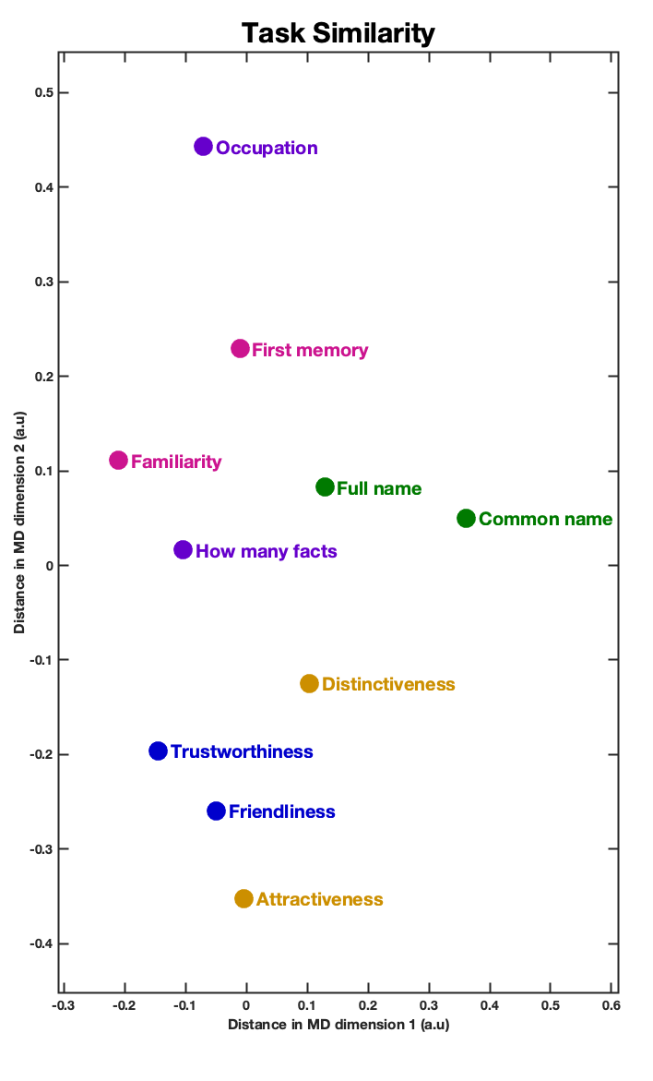
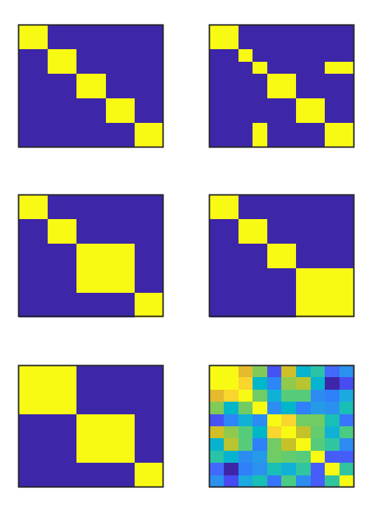
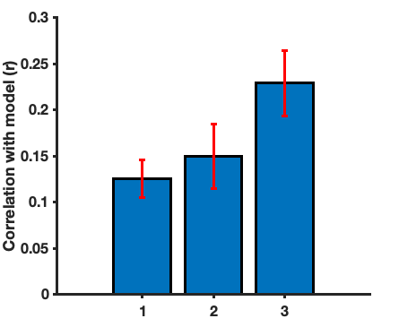
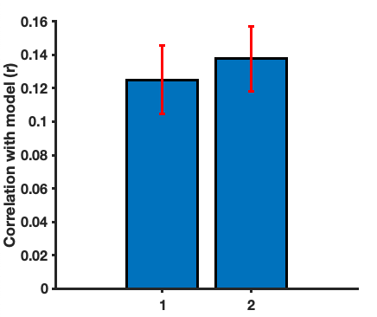
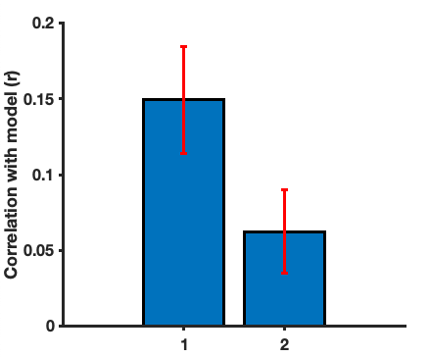
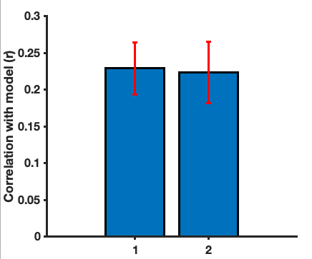

Model comparison Procedure
Pairs
Episodic+Biographical
Macro-Domain
**
**
Similarity model fit
Pairs posthoc
Episodic+Nominal
Empirical Model
Pairs
Ep+Bio
Model Visualisation
Macro-Domain
Best Model Macro Domain Grouping
Social/Perceptual judgements
n.s
*
n.s
Memory
Pairs
Ep+Bio
Nominal Knowledge
Pairs posthoc
Ep+Nom
Macro-Domain
Empirical Model

Slide 12
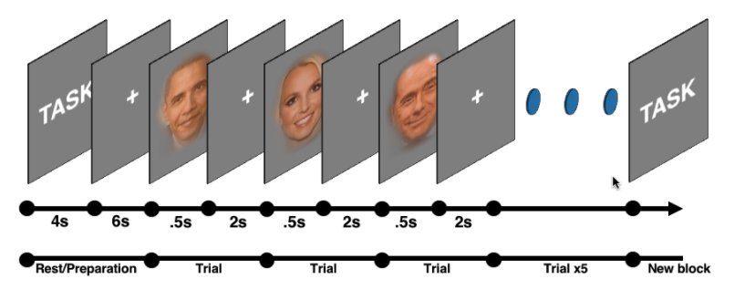
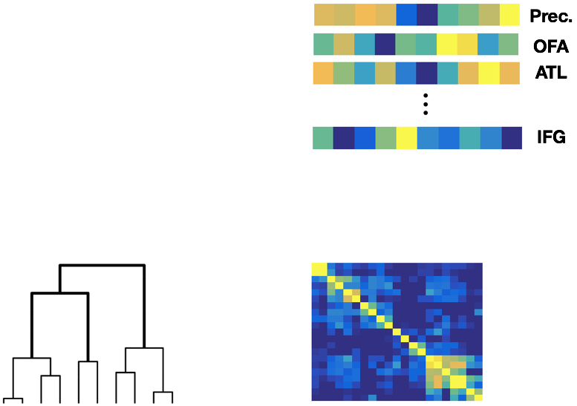
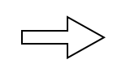

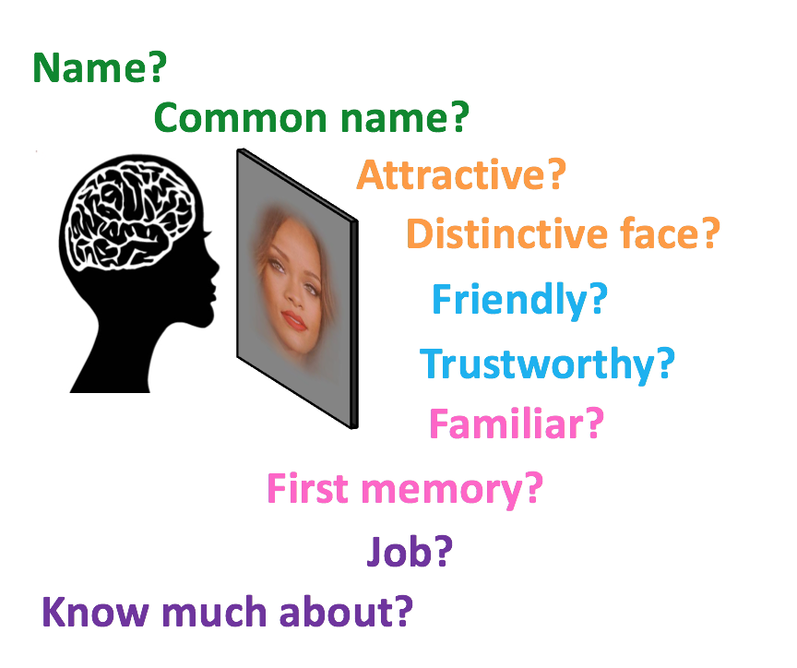
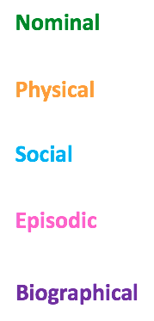
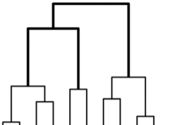
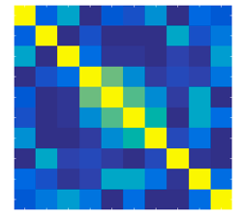
A)
Schema of the experiment
B)
GLM
Regional activation pattern
Independent ROIs (n=42)
Task
cognition specific brain map
Occupation?
Clustering analysis
Cortical pattern similarity

